Slide 1
PLEDGE YOUR SUPPORT
Connect with Grainy and serve for needy people

Slide 2
Problem Statement
Left Over Food Wastage
The objective of our system is to enable a link of communication and interaction among NGO's, donors and the needy.
It is crucial for all NGO volunteers to communicate with each other in order to give proper delivery to the needy people.

Slide 3
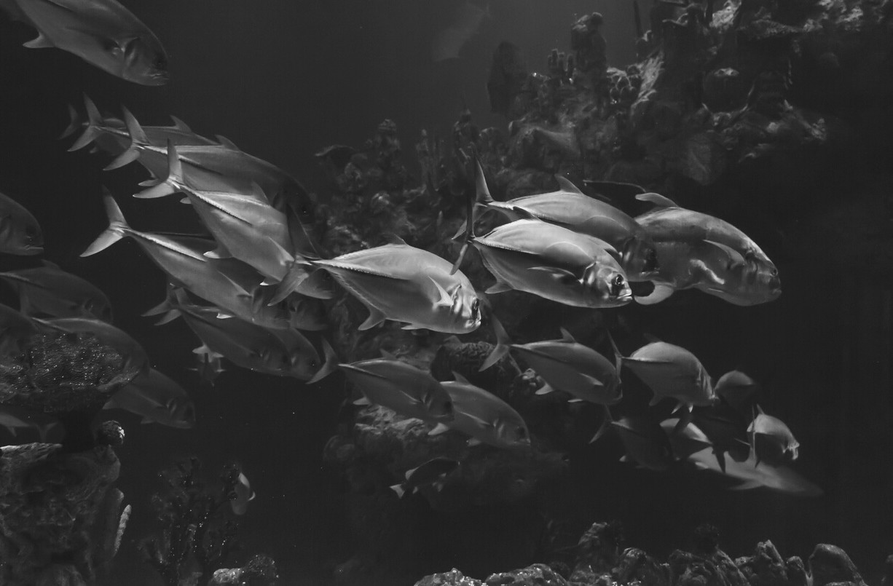

Reason Behind the Grainy
Our application aims to bring about transparency, clarity and swiftness in the process of donation thus aiming to mitigate prevailing issues in whatever zone it is possible for us to do so.
We are not only focuses in the hotels and restaurants also our main focus is to target waste food of all resources including marriage halls & party gathering garden

Slide 4


Front-end Technology
HTML CSS
Bootstrap Javascript
Technology Requirements
Back-end Technology
Solidity Hardhat Ether.js

Slide 5
In this system, we have tried to reduce restaurant food wastage by giving waste food to NGOs. NGOs will raise a request, in case of any leftover food restaurants have. This request is sent to the restaurant manager of that particular restaurant.
The NGO Manager then approves the request and assigns it to one of the NGO employees for takeaway and forwards the request to the restaurant. The leftover food at the restaurant can be given to NGOs at the end of the day. The admin can track the history of restaurants and NGOs for the leftover foods.

Slide 6
This Food Waste Management system can assist in collecting the leftover food from hotels ,restaurants and marriages to distribute among those in need. NGOs that are helping poor communities to battle against starvation & malnutrition can raise a request for food supply from restaurants through this application. Once the request is accepted, the NGOs can collect the food from the restaurants and marriage garden for its distribution. In this way this food waste management system will help restaurants and marriage to reduce food waste and will help in feeding the poor and needy people.

Slide 7
Thank You!!!!

